Slide 1

SQUASHED TOMATO CHALLENGE
Can you design and make a model to transport tomatoes down a mountainside in Nepal without squashing them?
Notes:
Introduce the challenge.
Explain that pupils will be using their STEM skills to try and solve a problem faced by
communities in a country in a different part of the world.

Slide 2
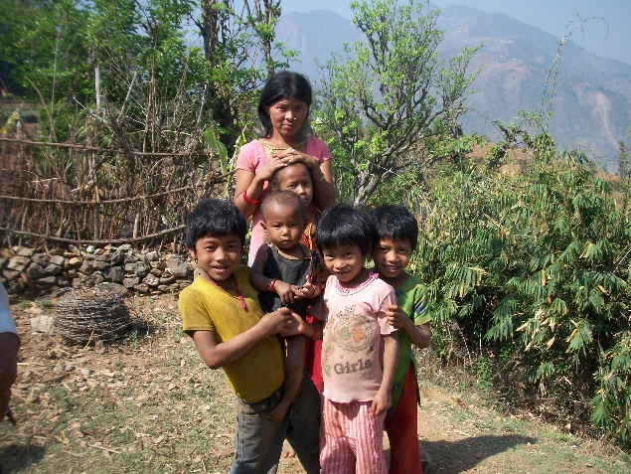
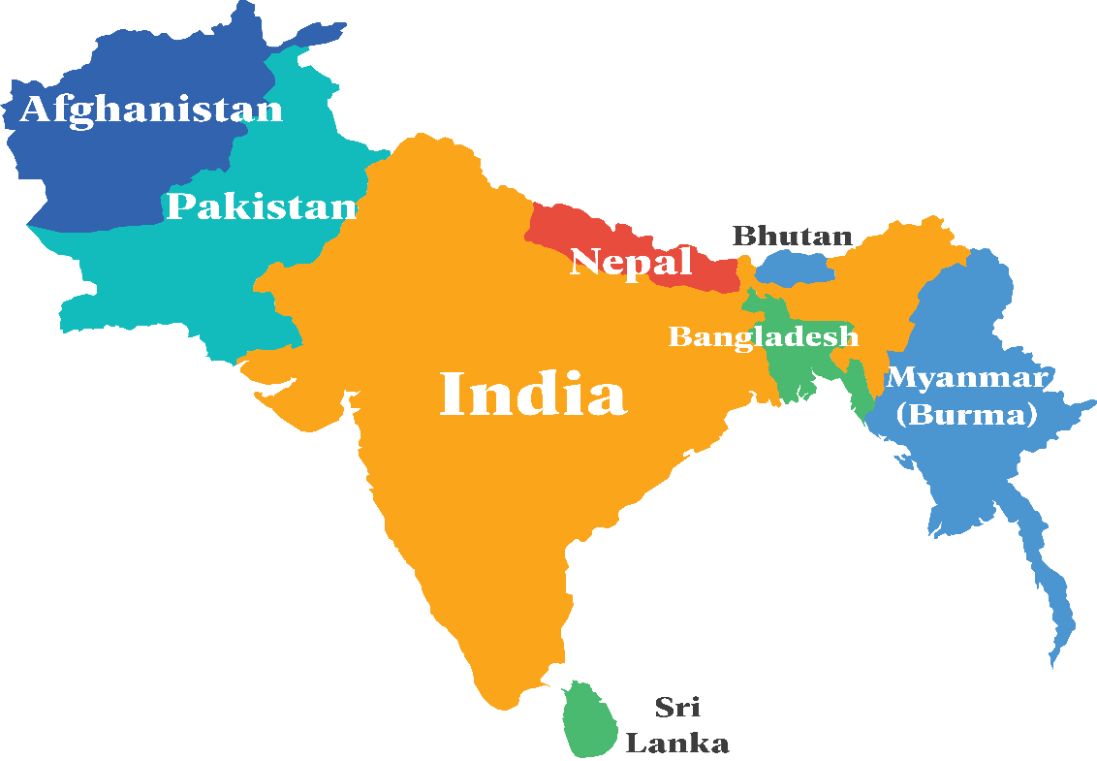
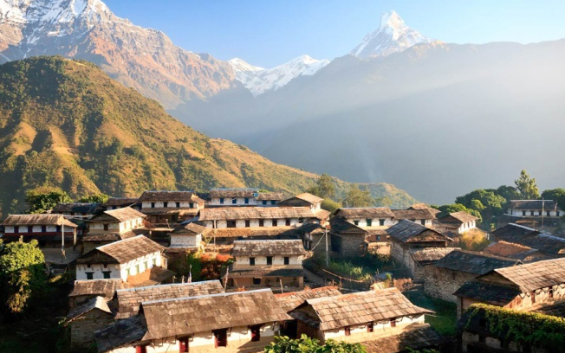
Nepal is a landlocked country in South Asia. It is located mainly in the Himalayas, but also includes parts of the North Indian River Plain.
Notes:
An introduction to Nepal.
It would be good to find out what pupils already know about Nepal. This may include:
Nepal is the birthplace of Buddhism, although many people in Nepal are Hindu.
Nepal is known for its mountain peaks. The small country contains eight of the 10 highest peaks in the world, including Mount Everest.
When two people in Nepal meet they say Namaste. It means both hello, and goodbye. As they say it they join their hands together and bring them up toward their chin.
The capital of Nepal is Kathmandu.

Slide 3
A problem
for farmers
Notes:
The problem pupils are going to try and solve is one faced by farmers living in Nepal .

Slide 4
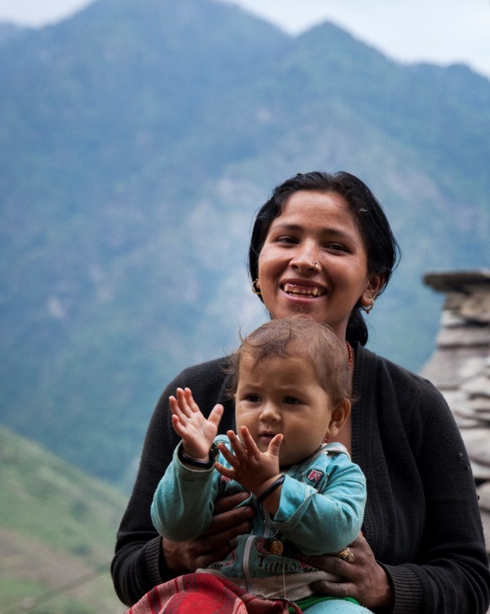
Many families living in the mountainous areas in Nepal grow crops to feed their families and to sell at local markets. Suchana Mijar is 20 and lives in the village of Mana, in the far west of Nepal, with her daughter Sonisa. Like many rural women, Suchana had to carry heavy loads to market whilst she was pregnant and once, she slipped, falling around 25 metres. Look at the pictures of where Suchana lives and think about some of the problems she might have living in the mountains.
Question: How would this affect her day-to-day life?
Question: How does this make life hard for her as a farmer who needs to sell her crops at the market at the bottom of the mountain?
Notes:
Introduce the context and a female farmer named Suchana. There is a printed case study to show later.
For the starter activity ‘Identifying challenge in Nepal’, hand out the Photographs of Nepal for discussion on what problems Suchana and her community might face.

Slide 5

Many people around the world face the same or similar problems as Suchana and Sonisa, trapping them in poverty. In 2015 the United Nations (UN) called a meeting with leaders from over 30 countries to work out how best to work together to solve some of the world’s biggest problems. They identified 17 goals to end poverty in the world by 2030. They called them: The Sustainable Development Goals, also called the Global Goals.
Notes:
Introduce the Global Goals. Do this by explaining that in 2015 the United Nations identified the
same problems the pupils have come up with, plus a few more as essential in solving world poverty.
The United Nations then came up with 17 Global Goals which they agreed to work towards to
help solve world poverty by 2030.

Slide 6

The Sustainable Development Goals (SDGs)
Notes:
This is the full set of Global Goals. You may want to print this out for display and/or to hand out.
Show to pupils and explain that they are also known as the Sustainable Development Goals, or
SDGs. You may like to discuss which ones they feel are most important and why.

Slide 7

Linking tomatoes to the Global Goals Think of all the different ways Suchana’s life may be improved if she can move her tomatoes to the market more safely and more quickly. How do you think this change in her life will help achieve the Global Goals below? Which goal do you think the last one is?
?
?
?
?
?
1.
2.
3.
4.
5.
Notes:
This slide explains the starter activity ‘Moving tomatoes and the Global Goals’. At this point hand
out the Sustainable Development Goals and Moving tomatoes and the Global Goals pupil worksheets
and introduce the task.

Slide 8
Your challenge!

Slide 9
Challenge: Imagine you are a group of engineers working together on Global Goal 11. You need to find a way to help farmers in Nepal transport their tomatoes down the mountain to market.
Design, make and test a model of a system that can transport tomatoes in a way that won't squash them!
.
Rules:
The tomatoes must be transported a minimum of one metre, not touching the ground.
The tomatoes cannot be touched whilst they are moving, catapulted or ‘flown’ in any way! They must be moved in a controlled way.
Notes:
Outline of the main rules for the challenge.
See the Teacher’s Guide for more details and prompt questions.
Hand out the design sheets and talk about the importance of testing and amending designs during the design and make process.

Slide 10
At the end of your challenge you will have three minutes to present or ‘pitch’ your work on the Squashed tomato challenge. Remember to leave time to work out how you are going to do this.
Notes:
Feedback is an important part of the challenge. We suggest that pupils present their model to the
rest of the class reflecting on how well they worked together, problems they solved etc. Allow time for pupils to work on their presentations as well as building their model.

Slide 11
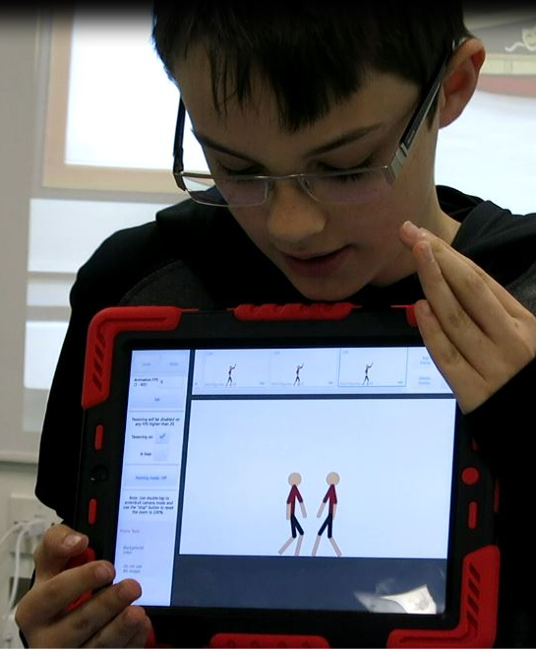
Feedback
Team work How well did you work together? Research What did you find out? Developing ideas What ideas did you try out and how did you change your design as a result? Final design How successful was it? How would you improve it if you had more time?
Notes:
These feedback categories are going to be used to judge which group wins the challenge, so it is
important pupils consider this when presenting.

Slide 12
How do they do it in Nepal?

Slide 13
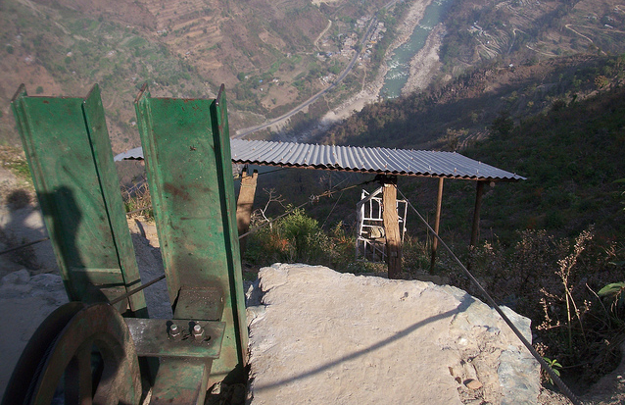
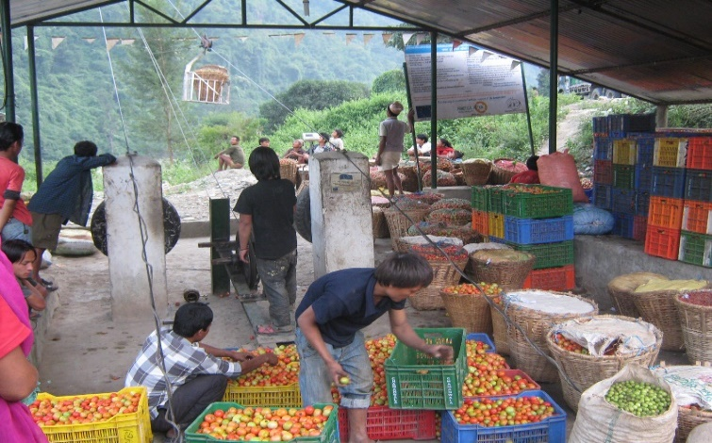
Now that you’ve had a go at transporting tomatoes yourselves, we’d like to show you the aerial ropeway systems Practical Action has worked with farmers in Nepal to develop that help them transport their produce to market. Top picture: this is the up station where tomatoes are loaded into baskets ready for their trip down the mountainside on the aerial ropeway. Bottom picture: this is the down station at the bottom of the mountain where the tomatoes arrive ready for a short journey to the market.
Question: Can you see the basket of tomatoes on its way down?
Notes:
Explain how the actual solution in Nepal works.
Use this, and the videos that follow, as an opportunity to discuss how different/similar the pupils model systems are.

Slide 14

Watch the video to find out how the system works.
Notes:
Videos
— www.youtube.com/watch?v=YAtIBXvnWFo
(the one above, showing how the ropeway works)
— www.youtube.com/watch?v=yJIxsUBIFuA
(focuses on the impact of the ropeway on families living on the mountains)

Slide 15

You will be pleased to know that Suchana’s life has been much improved as a result of Practical Action helping her community build a ropeway. ‘I was very happy when I saw the ropeway working because now we won’t ever need to carry heavy loads to and from the market again.’ Suchana is growing and selling more vegetables, and says her daughter is healthier. The ropeway is just one of the ways Practical Action and other organisations are working with communities around the world towards achieving the Global Goals.
Notes:
Hand out the pupil activity sheet Suchana’s story. Go back to the story of Suchana and
discuss how her life has changed for the better since the introduction of the aerial ropeways.

Slide 16
Celebrating Success

Slide 17







We hope you enjoyed the Squashed tomato challenge.
For more information and resources go to:
practicalaction.org/schools

